Slide 1
Collective Threat Intelligence Framework
PIP2001 Capstone Project
Review-3
Batch Number: CCS-G26
Roll Number | Student Name
20211CCS0169 | Ananya A B
20211CCS0106 | Aiswarya A S
20211CCS0109 | Jyotsna Banakar
20211CCS0052 | Vaibhav B Bharadwaj
Under the Supervision of,
Dr. Vennira Selvi
School of Computer Science and Engineering
Presidency University
Name of the Program: B-tech
Name of the HoD: Dr. Anandaraj S P
Name of the Program Project Coordinator: Dr. Sharmasth Vali Y
Name of the School Project Coordinators: Dr. Sampath A K / Dr. Abdul Khadar A / Mr. Md Ziaur Rahman

Slide 2
Introduction
Organization: Quick Heal
Category: Software
Problem Description:
Adopting a collaborative approach to sharing the threat intelligence has its own benefits. The volume of threat incidences along with sophistication of techniques used demands implementation of effective protective system. You always see only view through one angle and no one has the full picture. Ability to find needle in a haystack gives the notion of today's threat landscape. The system should build capability of collective threat intelligence to prioritize, focus and detect threats.
Difficulty Level: Complicated

Slide 3
Literature Review
With the increasing complexity and volume of cyber threats, no single organization can have full visibility into the global threat landscape. Collective threat intelligence is necessary to overcome this limitation by providing shared insights across industries, sectors, and geographies
Collective threat intelligence is necessary to overcome this limitation by providing shared insights across industries, sectors, and geographies.
Our projects “Collective Threat Intelligence System” mainly focuses on sharing information about vulnerabilities, threats and mitigations among various stakeholders of cyber security.
Threat intelligence is collected from a variety of different sources, and filtered and analysed to identify different types of threats

Slide 4
Existing method Drawback
One of the major issues in existing methods is huge amount of false negatives. Which overwhelms the analysis, so better prioritisation methods to handle data influx are needed.
Often organisations are reluctant to share sensitive data due to privacy and legal concerns. Which leads most of the threat intelligence data to stay under shadows.
Data fragmentation and lack of standardisation is another major reason as different organizations share data in different formats, which leads to difficulty in integrating data.

Slide 5
Proposed Method
The proposed method for our project will focus on developing a collaborative environment that integrates several open source tools to share and analyse this data and prioritise threats.
Our main objectives are:
Provide real time threat sharing
Implement data enrichment
Enable visualisation
Integrate machine learning models
Our project aims to overcome drawbacks of existing models and enhance detection capabilities by leveraging open source tools.

Slide 6
Objectives
To develop an open source threat intelligence platform that automates collection, enrichment and dissemination of threat across multiple organisations.
To address issues like false positives, data overloads and contextualised intelligence
Implement automated data enrichment.
Real time data sharing and scalability

Slide 7
Methodology/Modules
The methodology for our project will follow a structured approach with key phases:
Data ingestion : for collecting threat intelligence data from external source using MISP.
Data storage : stores the threat intelligence data.
Data visualisation : visualising the stored data, creating dashboards, and monitoring threat trends in real-time.
Incident response : automatically generate incident cases from incoming threat data, allowing for structured management of threats.
Data enrichment : enhances raw threat intelligence by querying external sources to gather additional context on indicators.

Slide 8
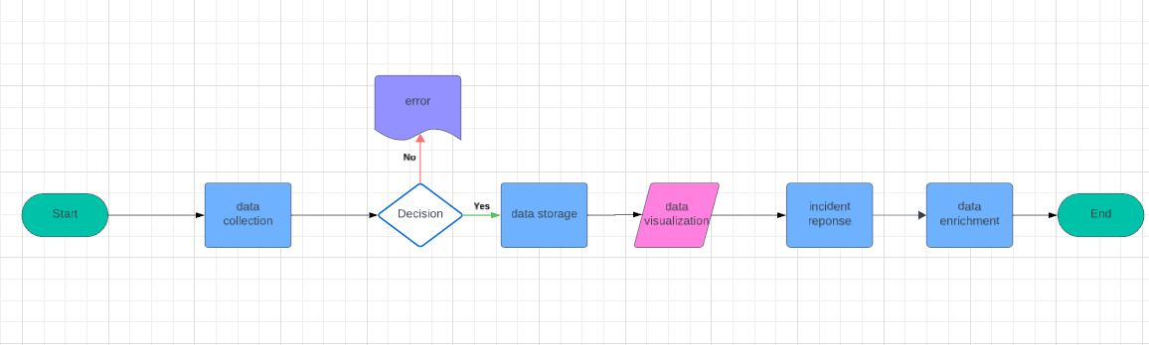
Architecture

Slide 9
Hardware/software components
Hardware Components
Server and Networking Equipment
Backup Storage
Software Components
Operating System
Windows / Mac OS
Threat Intelligence Platforms
TheHive
Cortex
Data Storage
Elasticsearch
MySQL
Data Visualization :
Kibana
Development Tools
Python
Java
Git
Security Tools
Wireshark

Slide 10
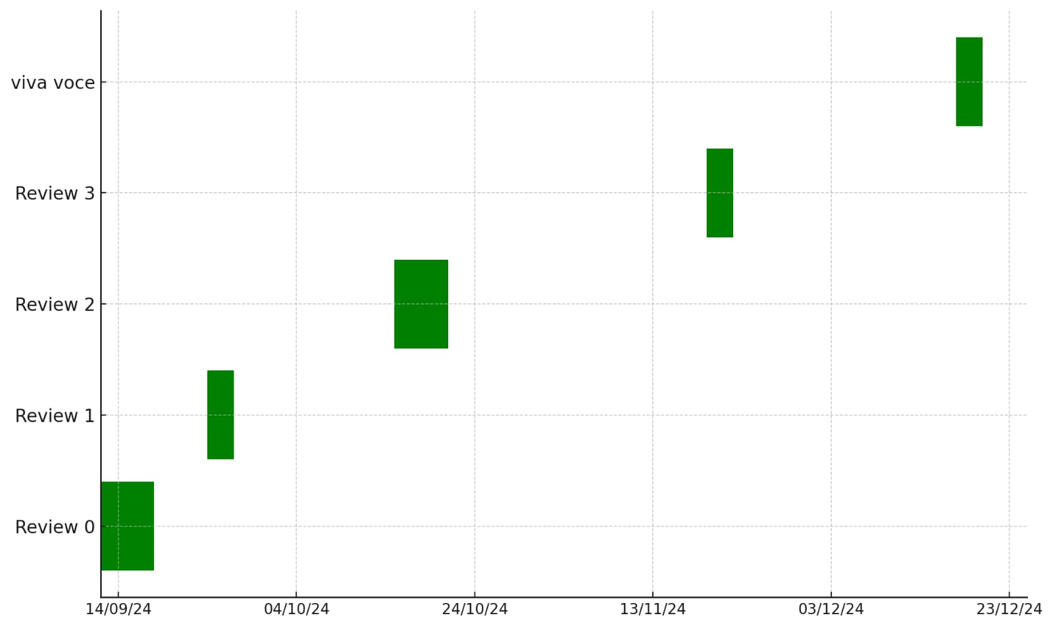
Timeline of Project

Slide 11
Expected Outcomes
Improved Threat Detection : Enhanced capability to identify and prioritize threats using collected data and advanced analytics
Centralized Threat Intelligence Repository
Data Visualization
Enhanced Data Enrichment : context to the collected data, making it more actionable and improving the understanding of potential threats
Collaborative Environment : A platform that enables multiple stakeholders (security teams, analysts) to collaborate effectively, sharing insights and improving overall threat response.
Documentation and Knowledge Sharing

Slide 12
Conclusion
Enhanced Cybersecurity: The project aims to improve threat detection and response capabilities within organizations.
Centralized System: Integration of tools like TheHive, and Elasticsearch creates a unified threat intelligence repository.
Data Visualization: Using Kibana for data visualization facilitates quick insights and informed decision-making.
Collaboration: Encourages teamwork among security analysts, fostering a culture of knowledge sharing.
Proactive Approach: Focus on data enrichment helps anticipate threats rather than just reacting to incidents.
Scalability: The architecture is designed to grow with the organization's needs, ensuring long-term effectiveness.
Compliance: Supports regulatory requirements by maintaining a documented audit trail of threats and responses.
Overall Impact: Establishes a comprehensive strategy for cybersecurity, enhancing organizational resilience against evolving threats.

Slide 13
Github Link
Github Link

Slide 14
References
Sciencedirectassets
https://www.researchgate.net/publication/377074580_CYBER_THREAT_INTELLIGENCE_SYSTEMS_AND_APPLICATIONS
https://patentimages.storage.googleapis.com/fe/98/40/b6c6f6fb59879a/US20140007238A1.pdf
https://patentimages.storage.googleapis.com/6b/bd/c2/573970b97cbd91/US9654445.pdf
https://patentimages.storage.googleapis.com/cd/ee/fc/f5325848ed05fb/US8813228.pdf
https://patentimages.storage.googleapis.com/50/0b/67/8c36334f0fe6ae/US8887286.pdf
https://patentimages.storage.googleapis.com/aa/43/c5/a22ef5decd2db5/US10469514.pdf
https://flare.io/learn/resources/blog/threat-intelligence-sharing/
https://docs.lib.purdue.edu/cgi/viewcontent.cgi?article=2103&context=open_access_theses
https://www.eccouncil.org/cybersecurity-exchange/threat-intelligence/leveraging-threat-intelligence-to-protect-against-cyber-threats/

Slide 15
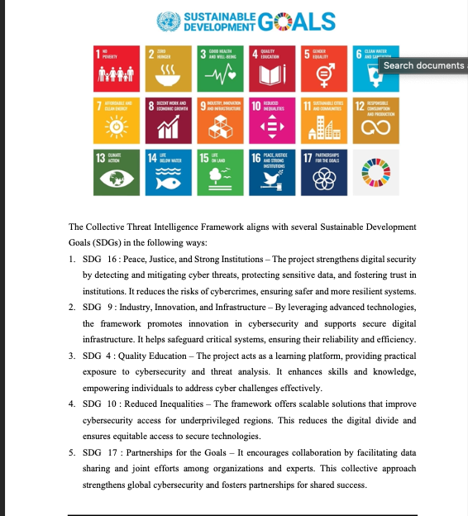
Project work mapping with SDG

Slide 16
Thank You

